Slide 1

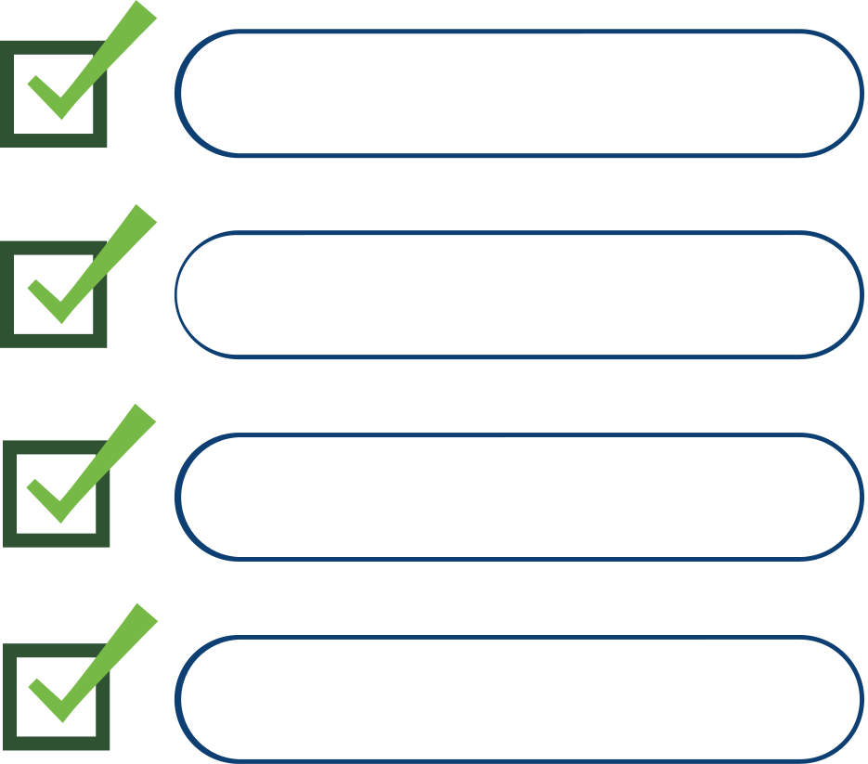









Confused Between Cement Suppliers? We Help You Choose the Best One
Supplier Optimization Model
ACC Cement
Who’s the Right Supplier?
Shree Cement
Ambuja Cement
Dalmia Cement
Too many things to decide!
Ultratech Cement
Best Price
Fastest Delivery
Flexible Credit
Constrilink empowers procurement teams to choose the most cost-effective and reliable supplier - removing guesswork and enabling data-backed cement procurement.

Slide 2





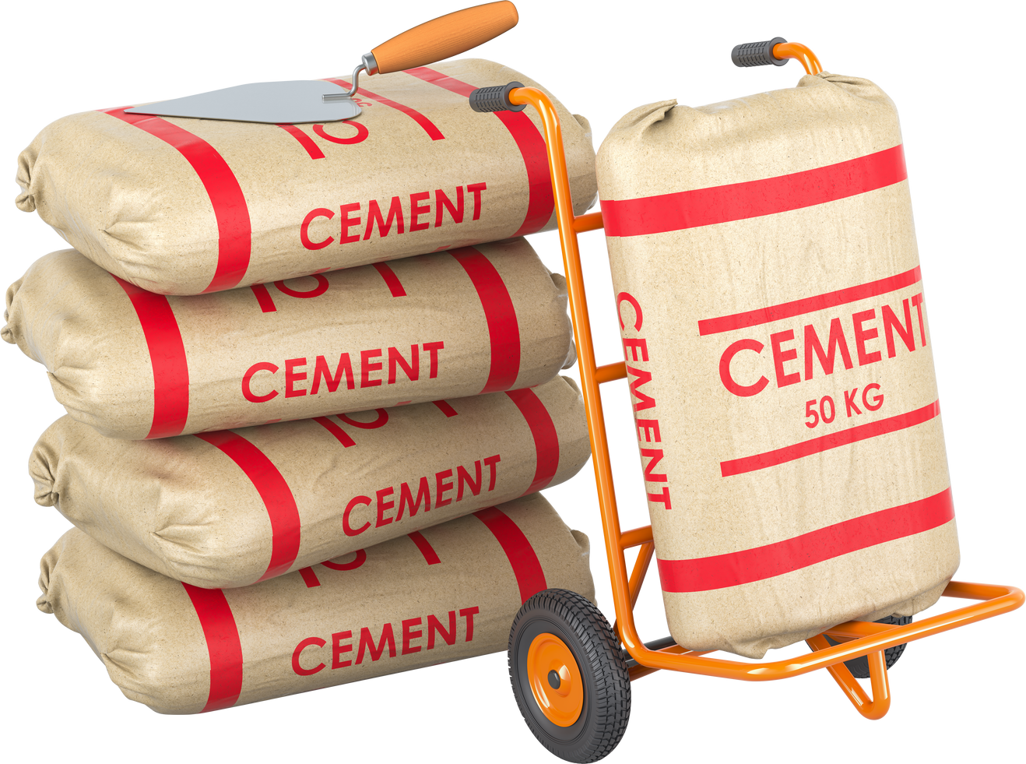
Send Cement Where It’s Needed - Not Where It’s Already Piling
Where should I send this cement now?
Intelligent Stock Allocation Model
Dispatched to site with real demand
Site A: Stock out
Site E: Overstocked
With Constrilink, you don’t just track cement - you manage it smartly across all sites, avoiding wastage and ensuring smooth construction flow, and better planning across all project sites.

